Slide 1
CAPM vs Fama–French Three-Factor Model
An Empirical Analysis Using 25 Size–Value Portfolios
A Data Analytics & Quantitative Finance Project
Itay Feigin
Tools: Python (pandas, statsmodels, matplotlib)
Github Repository: https://github.com/ItayF213/factor-models-capm-ff3

Slide 2
Motivation & Research Question
Motivation & Context
Asset pricing models aim to explain cross-sectional differences in portfolio returns
CAPM assumes market risk alone explains expected returns
Empirical evidence suggests additional systematic factors may matter
Research Question:
Does the Fama–French Three-Factor model provide better explanatory power than CAPM across diversified portfolios?

Slide 3
Data & Scope
Monthly returns of 25 size–value sorted portfolios
Portfolios constructed by independent size (ME) and book-to-market (BM) sorts
Factor data:
  Market excess return (MKT–RF)
  Size factor (SMB)
  Value factor (HML)
Sample period consistent across all portfolios

Slide 4
Methodology
Estimated time-series regressions for each portfolio
Two competing models:
  CAPM
  Fama–French Three-Factor (FF3)
Compared:
  Model fit (R²)
  Pricing errors (alpha)
  Statistical significance of alphas

Slide 5
Model Specifications
CAPM:
Excess Return = α + β(MKT−RF) + ε
Fama–French 3-Factor Model:
Excess Return = α + β(MKT−RF) + s(SMB) + h(HML) + ε
Note:
Models estimated separately for each of the 25 portfolios

Slide 6
Model Explanatory Power
Definition
R² measures how much variation in returns is explained by the model
Higher R² indicates better fit
Key numbers:
Average R² (CAPM): ~0.74
Average R² (FF3): ~0.91
Average improvement (ΔR²): ~0.18

Slide 7
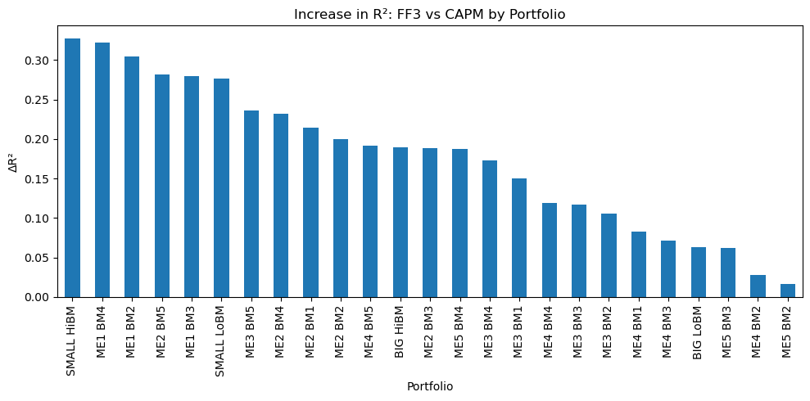
Increase in R²: FF3 vs CAPM
FF3 improves explanatory power for every portfolio
Largest gains observed in small and value-oriented portfolios
Indicates systematic patterns CAPM fails to capture

Slide 8
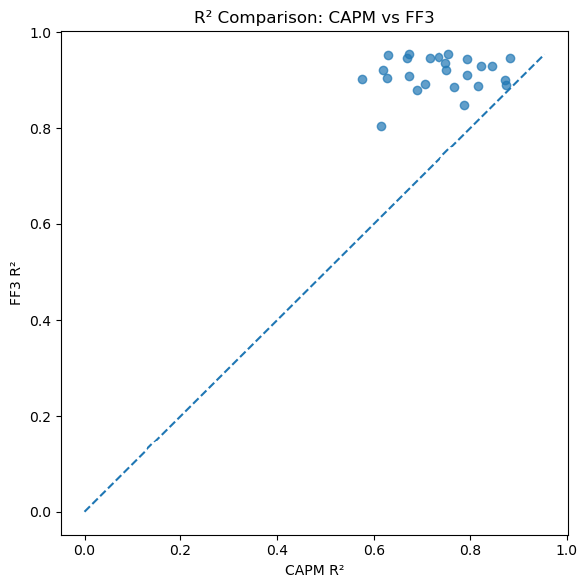
R² Comparison Across Models
All points lie above the 45-degree line
FF3 consistently dominates CAPM
Improvement is not driven by outliers

Slide 9
Pricing Errors and Model Misspecification
Interpretation
Alpha measures unexplained excess return
Statistically significant alpha suggests model misspecification
Results:
CAPM: 11 significant alphas (out of 25)
FF3: 6 significant alphas (out of 25)

Slide 10
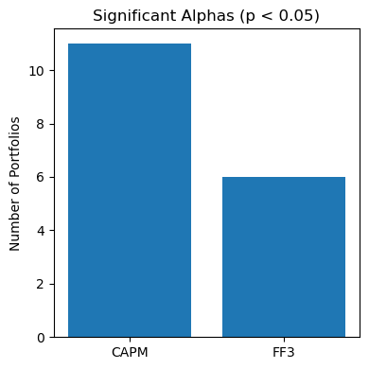
Significant Alphas by Model
FF3 reduces pricing errors substantially
Supports the inclusion of size and value factors

Slide 11
Interpretation
Size and value factors capture systematic risk ignored by CAPM
FF3 delivers:
  Higher explanatory power
  Lower pricing errors
Results align with established empirical asset pricing literature

Slide 12
Conclusion
FF3 significantly outperforms CAPM across diversified portfolios
Improvements are economically meaningful and statistically robust
Demonstrates how factor models enhance return explanation beyond market risk alone

